Slide 1
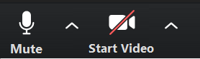

EE5104 Data Science
Today
Sensor Data Science : Process Overview
Turn your video on
Check out lecture materials posted in the syllabus
Up-to-date Syllabus: http://tiny.cc/y3wouz

Slide 2
An Overview of Sensor Data Analysis Process (Mobile vs. Fixed Sensing Cases)
Young Tae Noh
KENTECH

Slide 3
Sensor Data Gathering & Processing
Getting sensor data
From which sensors? (e.g., motion sensors, current sensors)
From where? Phone (wearable) vs. factory (stationary)
How? (e.g., wireless or wired, hierarchical?)
Processing sensor data
Why? For what? (e.g., activity recognition or fault detection)
How (procedure)
Sensor data processing pipeline: collect → segment → extract → classify
Sensor fusion – leveraging multiple sensors for better classification

Slide 4
Overview
Mobile Sensing with Smartphones
A Survey of Mobile Phone Sensing, IEEE Com Mag, 2010
Sensor Data Processing Pipeline
A tutorial on human activity recognition using body-worn inertial sensors, 2014
Industrial Applications: Machine Condition Monitoring and Fault Diagnosis
Design and deployment of industrial sensor networks: experiences from a semiconductor plant and the north sea, ACM SenSys 2005
Novel Industrial Wireless Sensor Networks for Machine Condition Monitoring and Fault Diagnosis, Liqun Hou and Neil W. Bergmann, IEEE Transactions on Instrumentation and Measurement, 2012

Slide 5
Mobile Sensing with Smartphones
A Survey of Mobile Phone Sensing, IEEE Com Mag, 2010

Slide 6
Contents
Applications
Eco-system Players
Scale of Mobile Sensing
Sensing Paradigm
Mobile Sensing Architecture
Sense
Learn
Inform, Share, Persuasion
Privacy Issues

Slide 7

Galaxy S20 Sensors
Accelerometer
Magnetometer (Compass)
Gyroscope
Ambient Light
Proximity
Camera
Voice
Pressure (Barometer)
NFC
Heart Rate
Fingerprint scanner
Notes:
8 Different types of sensors
Microphone and camera – most ubiquitous sensors

Slide 8
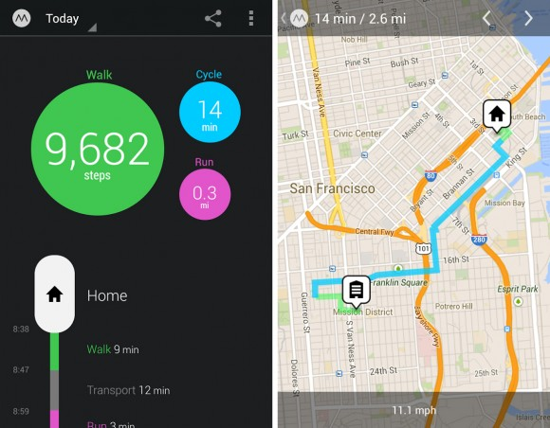

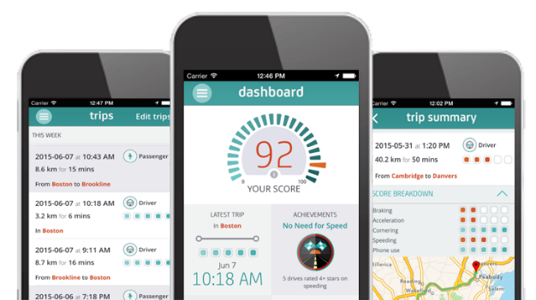
Applications
Health and Well Being
Promoting personal fitness (UbiFit Garden, Move, Google Fit)
Transportation
Traffic conditions (MIT VTrack, Nokia/Berkeley Mobile Millennium)
Driving behaviors (MIT DriveWell)
Social Networking
Sensing presence (Dartmouth CenceMe)
Environmental Monitoring
Measuring pollution (UCLA PIER)
Move
Drive Well

Slide 9
Eco-system Players
Multiple vendors
Apple AppStore
Google Play (Android Market)
Microsoft Mobile Marketplace
Developers
Startups
Academia
Small Research laboratories
Individuals
Critical mass of users

Slide 10
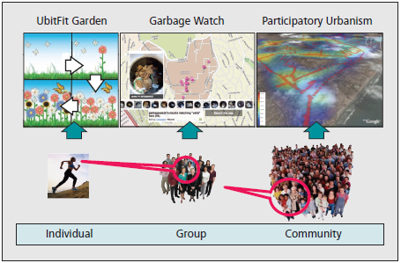
Scale of Mobile Sensing

Slide 11
Sensing Paradigm
Participatory: active sensor data collection by users
Example: managing garbage cans by taking photos
Advantages: supports complex operations
Challenges:
Quality of data is dependent on participants
Opportunistic: automated sensor data collection
Example: collecting GPS location traces from users’ phone
Advantages: lowers burden placed on the user
Challenges:
Technically hard to build – people underutilized
Phone context problem (dynamic environments)

Slide 12
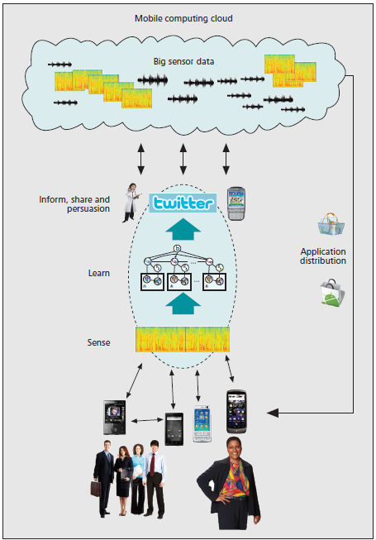
Mobile Computing Cloud
INFORM, SHARE AND
PERSUASION
Mobile Sensing Architecture
LEARN
SENSE

Slide 13
Sense
INFORM, SHARE,
PERSUASION
LEARN
SENSE
Programmability
Managing smartphone sensors with system APIs
Challenges: fine-grained control of sensors, portability (OS & sensor variation)
Continuous sensing
Resource demanding (e.g., computation, battery)
Energy efficient algorithms; trade-off between accuracy and energy consumption
Phone context
Dynamic environments affect sensor data quality
Some solutions:
Admission controls for removing noisy data
Collaborative multi-phone inference (i.e., using multiple sensors)
Time consuming
Most labor intensive work in sensor data science
Sensor data + label collection

Slide 14
Learn
INFORM, SHARE,
PERSUASION
LEARN
SENSE
Integrating sensor data
Data mining and statistical analysis
Learning algorithms
Supervised: data are hand-labeled (e.g., cooking, driving)
Semi-supervised: some of the data are labeled
Unsupervised: none of the data are labeled
Example: human behavior and context modeling
Activity classification
Mobility pattern analysis (place logging)
Noise mapping in urban environments
Notes:
Crowd Sourcing – CrowdSearch project – micro-payments used to incentivize people to improve automated image search
How well can mobile phones interpret human behavior or their surrounding environment?
Supervised learning is feasible for small-scale sensing applications, but unlikely to scale to handle wide range of behaviors and contexts
Unsupervised – problems with irrelevant classifications
SoundSense – general purpose sound classification system for mobile phones using combination of supervised (common sounds) and unsupervised learning (frequently re-occurring sounds of different users). Users confirms the classification of the sound (human in the loop, feedback).

Slide 15
Learn: Scaling Models
INFORM, SHARE,
PERSUASION
LEARN
SENSE
Scaling model to everyday uses
Dynamic environments; personal differences
Large scale deployment (e.g., millions of people)
Models must be adaptive and incorporate people into the process
If possible, exploit wisdom of crowd (or crowdsourcing) to improve data classification and solutions
Challenges:
Lack of common machine learning toolkits for smartphones
Lack of large-scale public data sets
Lack of public repository for sharing datasets, code, and tools

Slide 16
Inform, Share, Persuasion
INFORM, SHARE,
PERSUASION
LEARN
SENSE
Sharing
Data visualization, community awareness, and social networks
Personalized services
Profile user preferences, recommendations, persuasion
Persuasive technology – systems that provide tailored feedback with the goal of changing user’s behavior
Motivation to change human behavior (e.g., healthcare, environmental awareness)
Methods: self-reflection, goal setting, social competitions
Interdisciplinary research combining behavioral and social psychology with computer science

Slide 17
Privacy Issues
Respecting the privacy of the user is the most fundamental responsibility of a mobile sensing system
Reconstruction type attacks
Reverse engineering collected data to obtain invasive information
Second-hand smoke problem
How can the privacy of third parties be effectively protected when other people wearing sensors are nearby?
How can mismatched privacy policies be managed when two different people are close enough to each other for their sensors to collect information?
Notes:
UIUC Poolview project showed that even careful sharing of personal weight data within a community can expose information on whether a user’s weight is trending up or down.
Stronger privacy – security frameworks and standards

Slide 18
Privacy Issues
Understanding of privacy issues of novel mobile and wearable technologies is required
Furthermore, stronger techniques for protecting people’s privacy are needed
Current solutions
Cryptography
Privacy-preserving data mining
Processing data locally versus cloud services
Group sensing applications is based on user membership and/or trust relationships
Notes:
SoundSense, UbiSoft – processes data locally
Loopt, CenceMe, Google+, Facebook, etc. – group membership

Slide 19
Summary
Applications
Health & Well-being, transportation, SNS, environmental monitoring,
Eco-system Players
Vendors, developers, users
Scale of Mobile Sensing
Individual, Group, Community
Sensing Paradigm
Participatory vs. Opportunistic
Mobile Sensing Architecture
Sense
Learn
Inform, Share, Persuasion
Privacy Issues

Slide 20
Case Study of Mobile Sensing: Human Activity Recognition using Smartphones
A tutorial on human activity recognition using body-worn inertial sensors, Andreas Bulling, Ulf Blanke, Bernt Schiele, ACM Computing Surveys (CSUR) Volume 46 Issue 3, January 2014

Slide 21
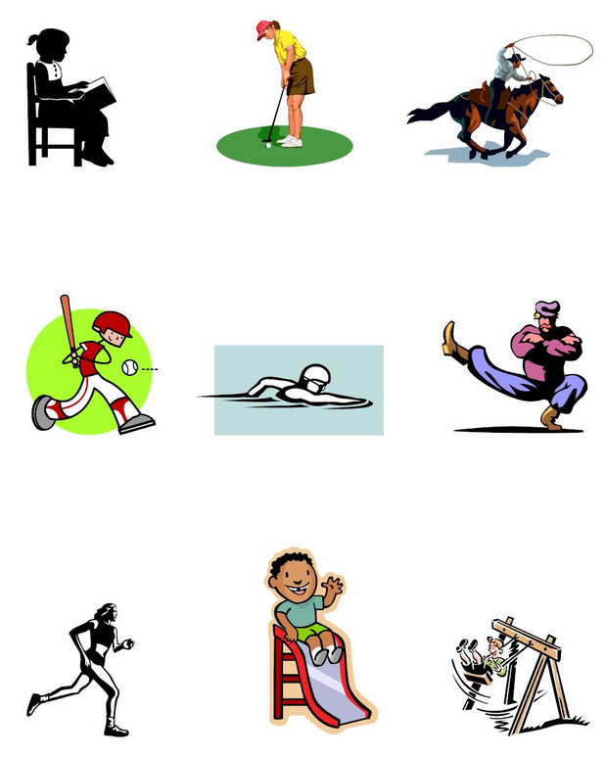
About Activities
High-level activities
Giving a lecture, having a breakfast, playing soccer…
Low-level activities
Lying on a bed, standing still, running, walking…

Slide 22
Case Study
Consider three target activities to recognize
Running
Standing still
Lying on a bed
How can we recognize these activities using your smartphone’s motion sensors?

Slide 23




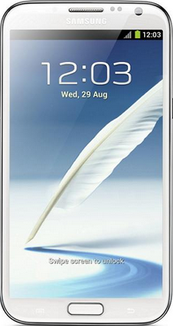
Activity Recognition Process
Motion sensors
accelerometer
compass
gyroscope
y
z
x
Data acquisition and pre-processing
Sensor Data
Segmentation
Data Segment
Feature extraction
Features
Model building & Classification (Inference)
Activity

Slide 24
Activity Recognition Process
Phone shaken? | Phone orientation? | Current Activity
No | Upright
Yes | Upright
No | Lying down
Yes | Lying down
Standing still
Running
y
Lying on a bed
Nothing (=Null)
z
x
Average value of accelerometer y-axis sensor signals for the last 2 seconds
(if avg. Y-axis >= alpha, it is upright; otherwise, lying)
Variance of accelerometer sensor signal for the last 2 seconds
(if variance >= beta, it is shaken)

Slide 25

Activity Recognition Process
Phone shaken? | Phone orientation | Activity
No | Upright | Standing still
Yes | Upright | Running
No | Lying down | Lying on a bed
Yes | Lying down | …?
Data acquisition and pre-processing
Classification
Sensor Data
Segmentation
Data Segment
Feature extraction
Average value of accelerometer y-axis sensor signals for the last 2 seconds
Features
Feature extraction
Model building & Classification (Inference)
Segmenting (=windowing)
Activity
Variance of accelerometer sensor signal for the last 2 seconds

Slide 26
Data Acquisition & Pre-processing
Collecting a stream of sensor data (e.g., using Android’s sensor manager interface)
Since most sensors provide data on some regular basis, we also need to know sampling rate (will learn more about this during DSP sessions)
An accelerometer, for example, may provide a stream of tuples of real numbers representing the acceleration in x, y and z-direction with 5 Hz
Cf) Android’s sensing rate configuration
Predefined rates: SENSOR_DELAY_NORMAL, UI, GAME, FASTEST
Or, the desired delay between events in microseconds
Actual rate is device-dependent; e.g., Nexus 5 (Normal/UI: 15 Hz; Game: 50 Hz; Fastest: 200 Hz)
Note that your smart devices will not guarantee such rates, and actual rate is dependent on its operating conditions (e.g., workload)
Notes:
http://stackoverflow.com/questions/9358862/impossibility-to-change-the-rate-of-the-accelerometer
https://developer.android.com/reference/android/hardware/SensorManager#registerListener(android.hardware.SensorEventListener,%20android.hardware.Sensor,%20int)
samplingPeriodUsint: The rate sensor events are delivered at. This is only a hint to the system. Events may be received faster or slower than the specified rate. Usually events are received faster. The value must be one of SENSOR_DELAY_NORMAL, SENSOR_DELAY_UI, SENSOR_DELAY_GAME, or SENSOR_DELAY_FASTEST or, the desired delay between events in microseconds. Specifying the delay in microseconds only works from Android 2.3 (API level 9) onwards. For earlier releases, you must use one of the SENSOR_DELAY_* constants.
https://developer.android.com/guide/topics/sensors/sensors_overview
In this example, the default data delay (SENSOR_DELAY_NORMAL) is specified when the registerListener() method is invoked. The data delay (or sampling rate) controls the interval at which sensor events are sent to your application via the onSensorChanged() callback method. The default data delay is suitable for monitoring typical screen orientation changes and uses a delay of 200,000 microseconds. You can specify other data delays, such as SENSOR_DELAY_GAME (20,000 microsecond delay), SENSOR_DELAY_UI (60,000 microsecond delay), or SENSOR_DELAY_FASTEST (0 microsecond delay). As of Android 3.0 (API Level 11) you can also specify the delay as an absolute value (in microseconds).

Slide 27
Data Segmentation
Example
For feature extraction, we need to “identify” those data segments that are likely to contain information about activities (known as “activity detection” or “spotting)
Sliding window: using a window (=frame) of samples, and simply slide that window with fixed overlapping (e.g., 50%)
Energy based: different activities have different activity “intensities” (or energy) (e.g., rest vs. others) – moving avg. can be used for automatic segmentation
In our example, to recognize basic physical activities we collect the data of 2 seconds from the accelerometer.
This corresponds to 10 readings of the acceleration data (if sampling rate is fixed to 5Hz)
Segmenting the sensor data using a window of 2 seconds with an overlap of 1 second
1
2
3
4
(time)
x, y, z
x, y, z
x, y, z
x, y, z
x, y, z
x, y, z
x, y, z
x, y, z
x, y, z
x, y, z
x, y, z
x, y, z
x, y, z
x, y, z
x, y, z
x, y, z
x, y, z
x, y, z
x, y, z
x, y, z
W1
W2
W3

Slide 28
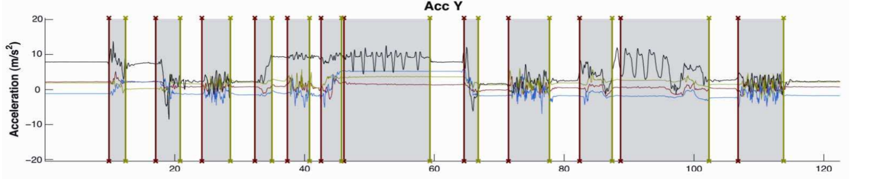
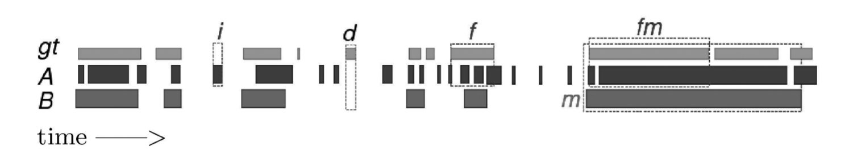
Practical Issues
Continuous sensing – not every data has labels
Sliding window may result in wrongfully classifying “NULL” class to some other classes
Label
No Label
= NULL class
https://doi.org/10.4108/ICST.BODYNETS2009.6036
Errors: insertion, deletion, fragmentation, merging
gt: ground truth 2 models: A, B (B w/ smoothing)
https://dl.acm.org/doi/pdf/10.1145/1889681.1889687

Slide 29
Feature Extraction
How to extract features?
Signal-based features – mean, variance, kurtosis
Body model features – exploiting prior knowledge about human kinematics
Event-based features – if there are any events (e.g., a sequence of eye movements – saccades, fixations, or blinks)
Multilevel features – duration, frequency, co-occurrence, clustered data/labels
In our examples, we extract the following features:
Average value of accelerometer’s y-axis signals
Variance of accelerometer sensor signals
1
2
3
4
(time)
x, y, z
x, y, z
x, y, z
x, y, z
x, y, z
x, y, z
x, y, z
x, y, z
x, y, z
x, y, z
x, y, z
x, y, z
x, y, z
x, y, z
x, y, z
x, y, z
x, y, z
x, y, z
x, y, z
x, y, z
W1
W2
Average Y
Variance

Slide 30
Classification
After extracting important features from the raw data, we use a classifier to determine the current activity
Many different classification algorithms exist, and depending on the application domain, there may be one algorithm that shows the best performance
Depending on the algorithm, the result is either a crisp decision (e.g., decision tree), or a probability distribution over activities (e.g., Naïve Bayes)
Learning algorithms: supervised vs. unsupervised (based on whether training dataset is used or not)

Slide 31
Classification Example: Decision Tree
Phone Orientation
Upright
(avg. Y-axis >= alpha)
Lying down
(avg. Y-axis < alpha)
Phone Shaken
Lying on a bed
Yes
(variance >= beta)
No
(variance < beta)
Running
Standing still

Slide 32
Summary
Accelerometer
Data acquisition and pre-processing
a := (a_{x}, a_{y}, a_{z})
f = 5hz
Sensor Data
Segmenting
Segmenting
a[1, 2, …, 10]
Corresponds to 2s
Data Segment
Y-Axis & Variance
Feature extraction
Y-axis = 6
Variance = 15
Features
Decision Tree
Model building & Classification (Inference)
Running, Standing, Lying
Activity

Slide 33
Application Research Papers
RecoFit: Using a Wearable Sensor to Find, Recognize, and Count Repetitive Exercises, ACM CHI 2014
iSleep: Unobtrusive Sleep Quality Monitoring using Smartphones, Sensys 2013
Dog's life: Wearable Activity Recognition for Dogs, Ubicomp 2013
Automatic Assessment of Problem Behavior in Individuals with Developmental Disabilities, Ubicomp 2012
Using Mobile Phones to Determine Transportation Modes, ACM TOSN 2010

Slide 34
Industrial Applications: Machine Condition Monitoring and Fault Diagnosis
Design and deployment of industrial sensor networks: experiences from a semiconductor plant and the north sea, ACM SenSys 2005

Slide 35
Predictive Analysis for Machine Condition Monitoring using Sensors
Vibration analysis: checking amplitude/frequency patterns of machine vibration
Oil analysis: checking particles, viscosity, acidity
Temperature analysis w/ thermal camera or temperature sensors (e.g., thermocouples): finding abnormal heat sources by comparing to baseline data for temperature changes
Ultrasonic detection: checking ultrasonic frequencies to detect faults (e.g., corrosion, wear patterns)
Notes:
Vibration Analysis: Time domain and frequency domain waveform analysis identifies changes in amplitude and frequency patterns, suggesting repair or replacement. This technology presumes that source vibration frequencies can be identified and assigned to specific components of the test subject.
Oil Analysis: In depth analysis of wear particles, viscosity, acidity, and raw elements. By capturing a small sample of oil from a source and comparing to baseline samples, potential problems can be seen well in advance of a failure.
Infrared Thermography: Specialized cameras and detection probes sense heat at frequencies just below visible light. Operators can detect abnormal heat sources and compare to baseline data for temperature changes. Because infrared cameras detect relative heat, they are also useful in detecting cold areas, liquid levels in vessels, and escaping gases.
Ultrasonic Detection: Ultrasonic frequencies are captured to detect wall thickness, corrosion and blistering, erosion, flow dynamics, and wear patterns. By comparing data to standards, change rates can be measured and lifetimes projected.

Slide 36
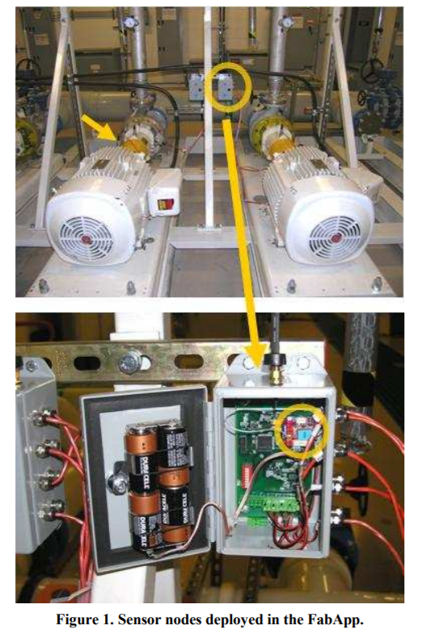
Sensors
Vibration Sensor
Data Collection Unit (Sensor Node)

Slide 37
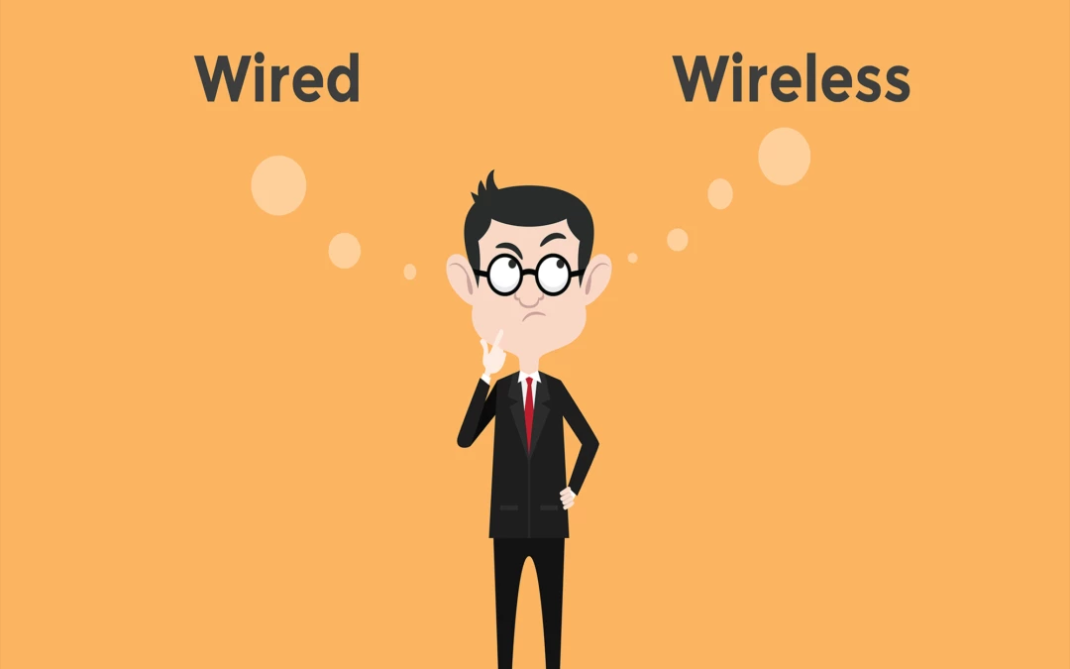

How to Configure Sensor Nodes? Wireless vs. Wired?

Slide 38
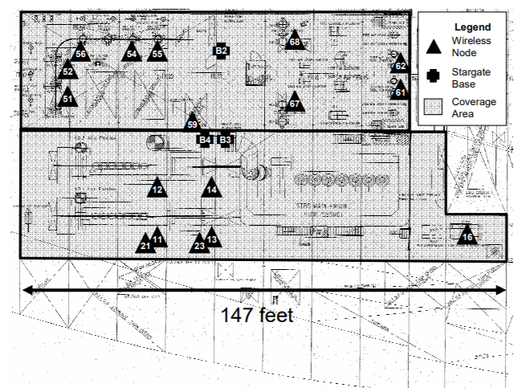
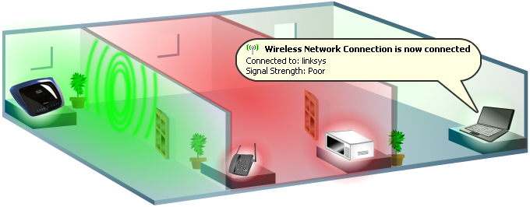
How to Configure Sensor Nodes? Wireless vs. Wired? 1) RF Coverage/Bandwidth/Interference
RF Coverage: How are sensors wirelessly covered? How much bandwidth can they deliver?
Conduct a site-survey to identify shadows caused by obstructions in the environment
Help to decide whether to add resources, such as relay nodes or additional gateways, to ensure coverage
RF Interference: How is the quality of wireless connections?
Are there any interference sources?
What’s the network Quality of Service (QoS) (e.g., bandwidth, delay) under RF interference?

Slide 39
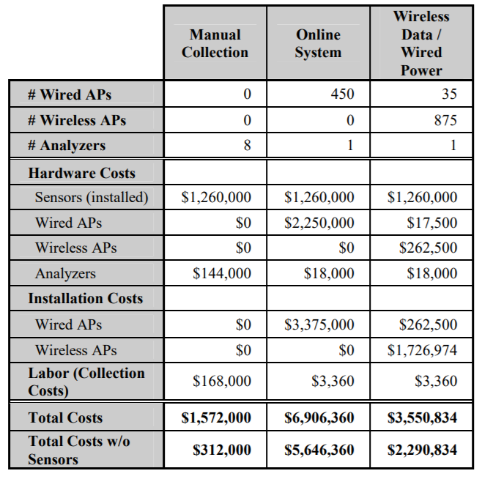
How to Configure Sensor Nodes? Wireless vs. Wired? 2) Cost
Notes:
Both manual and online systems are in place across a variety of applications and industries; however, they are not always a good fit.
Manual data collection is insufficient in many applications due to the potential for user error, the high cost to train and keep experts, and the manpower required for frequent data collection.
Online systems allow more reliable and frequent data collection.
However, the cost of purchasing and deploying the modules and the network and power infrastructure can be prohibitive.
Online solutions are appropriate for equipment and systems with a potential cost impact greater than $250K.
For the majority of equipment in a typical industrial deployment, an online system provides an insufficient return on investment.
An industry cross section shows that online system penetration into the market is less than 10%, primarily due to cost.
In the remaining 90% of the market, 20% use manual data collection, and most are not happy with the level of prediction and correlation they provide. Finding a solution to address this market and tap into the remaining 70% may represent a killer application for wireless sensor networks.

Slide 40
Industry Requirements
Fault tolerance and reliability
Long-lived battery powered operations
Maintainable
Seamless integration into existing applications
Security

Slide 41
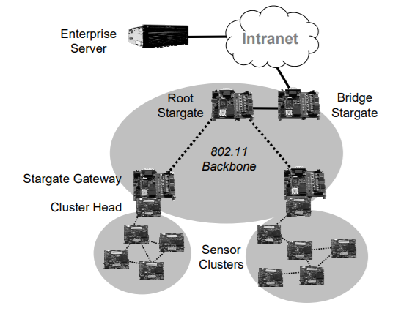
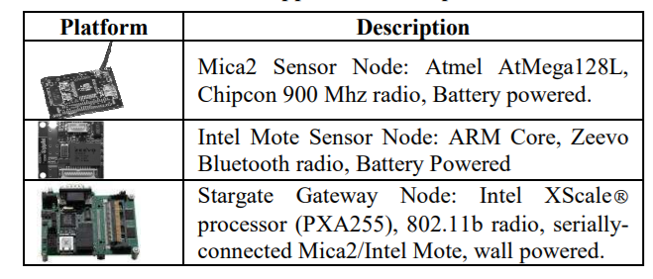
Deployment Experience
1 Server
4 Stargates
26 sensor nodes
150 accelerometers
Network Architecture

Slide 42
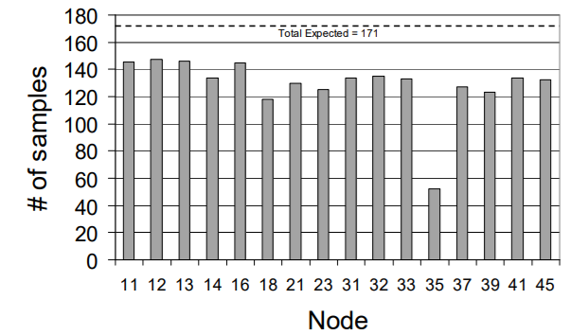
Deployment Experience
Majority of the nodes successfully delivered results at least 80% of the time
Failures were highly correlated within a particular sensor network cluster
Histogram of total number of vibration samples received/node from the starboard deployment of a 19 week period

Slide 43
Industrial Applications: Machine Condition Monitoring and Fault Diagnosis
Novel Industrial Wireless Sensor Networks for Machine Condition Monitoring and Fault Diagnosis, Liqun Hou and Neil W. Bergmann, IEEE Transactions on Instrumentation and Measurement, 2012

Slide 44
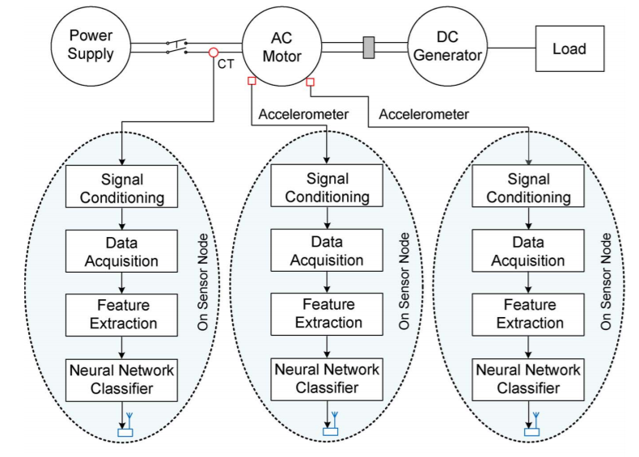
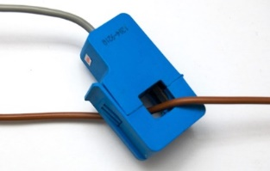
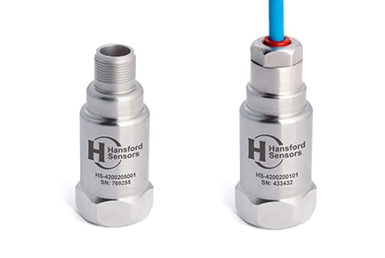
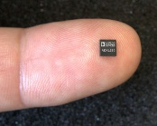
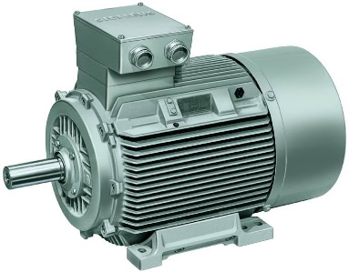
AC Motor Failure Monitoring
Current transformer (CT) sensor
Current Values (Amperes)
Acceleration Values (m/s²)
Industrial vibration sensor
MEMS
sensor
(H_OC) Healthy motor without resistor load on the DC generator side (the dc generator is open circuit)
(H_R15) Healthy motor with 15-Ω resistor load on the DC generator
(LF_R15) Fault 1: motor subjected to loose feet with 15-Ω load
(18g I_R15) Fault 2: 18-g imbalance with 15-Ω load
Cf. CT sensors: Current transformers (CTs) are sensors that measure alternating current (AC)
Loose feet

Slide 45
AC Motor Failure Monitoring
Stator current (SC)
Vibration/Head (VH)
Vibration/End (VE)
Cf. CT sensors: Current transformers (CTs) are sensors that measure alternating current (AC)

Slide 46
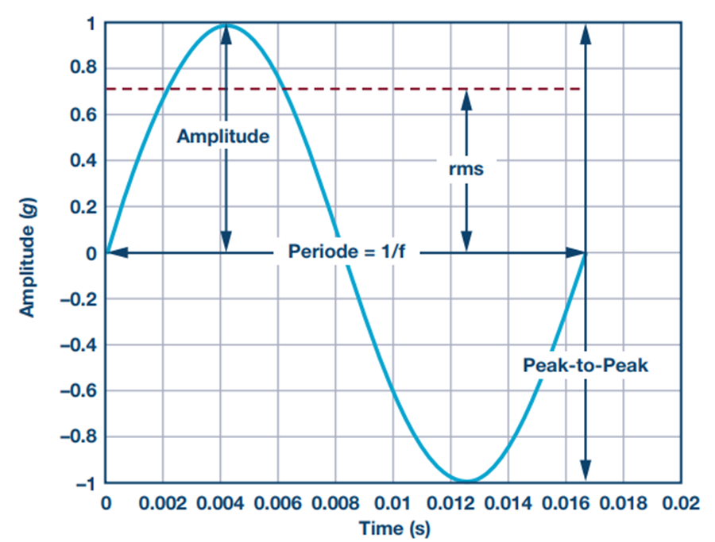
Feature Extraction
* Acceleration signature peak-to-peak (P-P) amplitude and variance values from a window of 512 samples
Cf. CT sensors: Current transformers (CTs) are sensors that measure alternating current (AC)
Notes:
Acceleration signature peak-to-peak amplitude and variance values (the variance of 512 samples within one fast Fourier transform (FFT) window) are selected as vibration signal fault features in the time domain, while the 12 most frequently occurring frequency components were counted and selected as the fault features in the frequency domain. These fault features will be used to classify the healthy motor and the motor subjected to loose feet or mass imbalance.
Stator current signal is employed to identify motor load changes. Motor load changes or faults will affect the load torque of the motor.
Continuous monitoring of the amplitude of the stator current signal can be used to find the abrupt change of load due to load side faults such as a broken connection shaft.
In addition, periodic load torque changes with the rotational speed can affect the stator current signal spectrum and produce the current harmonics.
In this paper, the load changes are tested by the modulation of a resistor connected to a generator used as a load, which is not a cyclic load variation, and do not give other current harmonics. Therefore, for the stator current signal, only peak-to-peak amplitude and variance value in the time domain are selected as fault features.
The selected fault features in this experiment are summarized in Table I.
For the vibration signal, the inputs of the neural network were the 14 fault features (x1, x2,...,x14) extracted as described earlier (12 frequency features, peak-to-peak current amplitude, and variance).
For the stator current signal, the inputs of the neural network were two features in the time domain: the peak-to-peak amplitude and variance.

Slide 47
Model Training

Slide 48
Data Collection Environment
Motor rotational speed is about 960 r/min (= 16 r/s)
JN5139 sensor board:
IEEE 802.15.4 and ZigBee protocols
Dataset:
Training data: 15 measurements for each condition (a total of 60 measurements)
Testing data: 6 measurements for each condition (a total of 24 measurements)

Slide 49
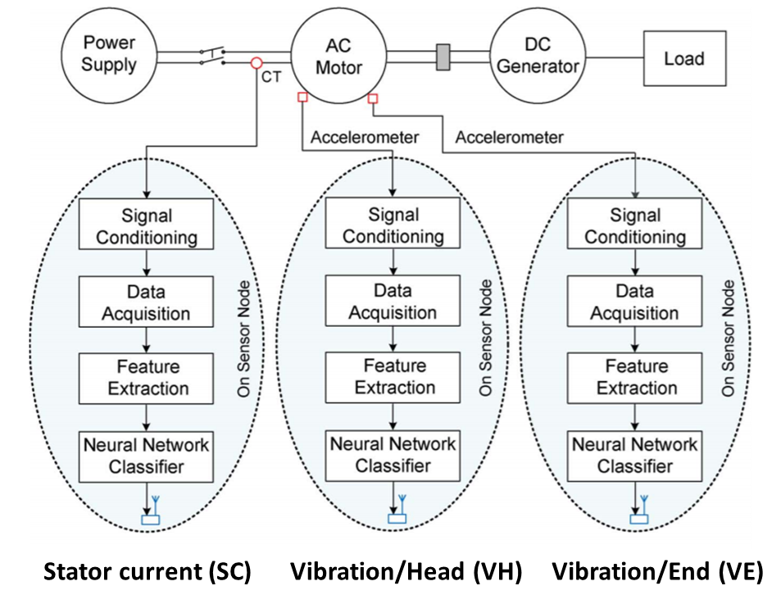
Performance Comparison
The worst diagnosis results for each motor operating condition are shaded
H_OC Healthy motor without resistor load (open circuit)
H_R15 Healthy motor with 15-Ω resistor load on the DC generator
LF_R15 Fault 1: motor subjected to loose feet with 15-Ω load
18g I_R15 Fault 2: 18-g imbalance with 15-Ω load

Slide 50
Performance Comparison
The best diagnosis results with conditional fusion are shaded
H_OC Healthy motor without resistor load (open circuit)
H_R15 Healthy motor with 15-Ω resistor load on the DC generator
LF_R15 Fault 1: motor subjected to loose feet with 15-Ω load
18g I_R15 Fault 2: 18-g imbalance with 15-Ω load
Notes:
Third, fault diagnosis based on data fusion using the outputs of two primary vibration classifiers is conducted, and the selected fault diagnosis results by classifier fusion are given in Table V. We can see that one fusion result is 0.8318 for the healthy motor with 15-Ω load, while all of the other results are more than 0.97.
Fourth, the diagnosis results of three primary vibration classifiers were combined. From Table V, we can see that one fusion result for the motor subjected to 18-g imbalance (last row, right column) is 0.8401, which has decreased from 0.9883 from the result using two-vibration-classifier data fusion. This
is because of the fusion of a wrong result given by the stator current classifier.
Fifth, the proposed data fusion approach with two steps was conducted. Two vibration classifiers were first fused.
The result of the stator current classifier is then combined or not, depending on the fusion results of the two vibration classifiers.
If the primary fusion result of the two vibration fault classifiers shows that the motor is a healthy one, the diagnosis result of the stator current classifier will be fused with the primary fusion result to further detect whether there is a load fault.
If the primary fusion result of the two vibration fault classifiers indicates that the motor is subjected to the loose feet or imbalance, the result of the local stator current classifier will not be used in the second fusing step, and the fusion result of the two vibration classifiers will be the final diagnosis result.
From Table V, it is clear that all of the final fusion results using this two-step fusion approach (shaded cells) are more than 98%.
The data fusion results using three classifiers (VH, VE, and SC) for LF_R15 and 18g I_R15 have a strikethrough to indicate that these fusion results are not used as the final result

Slide 51
Summary
Getting sensor data
From which sensors? (e.g., motion sensors, current sensors)
From where? Phone (wearable) vs. factory (stationary)
How? (e.g., wireless or wired, hierarchical?)
Processing sensor data
Why? For what? (e.g., activity recognition or fault detection)
How (procedure)
Sensor data processing pipeline: collect → segment → extract → classify
Sensor fusion – leveraging multiple sensors for better classification

Slide 52
Summary
Mobile Sensing with Smartphones
Scale of mobile sensing (individual, group, community)
Sensing paradigm: participatory vs. opportunistic
Sense => Learn => Inform, Share, and Persuade
Sensor Data Processing Pipeline
Key steps: Data Collection => Segmentation => Feature Extraction => Model Building => Evaluation
Industrial Applications: Machine Condition Monitoring and Fault Diagnosis
Manual vs. Online (wired vs. wireless) : cost & efficiency matters
Wireless sensor networks: lower costs (no wires), but be careful about RF inferences, data loss, and battery issues
Multiple sensors can be used for diagnosing machine faults

